Slide 1
What can we learn from legal cartels for competition policy?
Otto Toivanen
Aalto University, Helsinki GSE & CEPR
23.6.2022

Slide 2
Contents
Why study legal cartels?
Some examples of studies using data on legal cartel
Quasi-experiments in competition policy

Slide 3
Elusive cartels
Antitrust continues to be of major importance
Illegal cartels are a challenging object:
  We know a lot about the exposed illegal cartels
  We know nothing about the unexposed illegal cartels
Q1: Is there a cartel in market m in period t?
Q2: In what dimensions are the exposed (il)legal cartels a non-random sample of all cartels?

Slide 4
Upside of legal cartels
Contrary to what one might think, legal cartels are not an aberration
Sherman act in 1890…
Cartels became illegal in Finland, Sweden, Norway, Austria in the 90s
…1990s
See e.g. Fellman, Susanna, Martin, Shanahan (eds.) 2016. Regulating Competition - Cartel registers in the twentieth-century world. Explorations in Economic History. Routledge.

Slide 5
Upside of legal cartels
Link to modernity: Legal cartels provide a counterfactual: how many cartels and of what type would be observe in the absence of antitrust?
Many things observable that usually not available

Slide 6
Upside of legal cartels
Data source: In many countries, cartels were required to register.
Large numbers of cartels observed:
  Finland: some 900 cartels
  Norway: close to 500
  Austria: 120+
Many characteristics of cartels are observed:
  Cartel contracts observed and also codified for several countries.
  See e.g. Hyytinen, Steen and Toivanen, 2019. An anatomy of cartel contracts, Economic Journal and
  Fink, Schmidt-Dengler, Stahl and Zulehner, 2017. Registered cartels in Austria: an overview, European Journal of Political Economy)
Also of potential interest: an older descriptive literature (see HST 2019 Table A1 for 13 references)

Slide 7
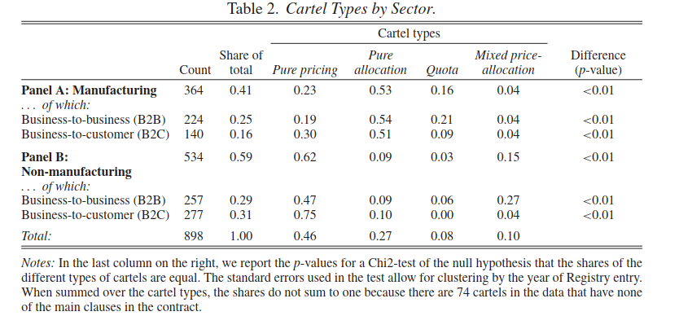
What do cartels look like? (HST EJ2019)
Useful for competition policy: what to look for and where?

Slide 8
What do cartels look like? (HST EJ2019)
Quota cartels have
  More complicated contracts
  Contract enforcement
  Clauses on non-cartel supply
  Dispute resolution

Slide 9
How many cartels are there?
Central question for antitrust (Q1): Is there a cartel in a given market at a given point in time?
Hyytinen, Steen and Toivanen, 2018. Cartels uncovered, American Economic Journal: Microeconomics
HST study 193 Finnish manufacturing cartels
HST study how many cartels there were when there was no antitrust

Slide 10
How many cartels are there?
Problem: cartels are observed in the Finnish registry only occasionally.
➔ outside observer cannot always know whether the cartel is “alive” or not
➔ HST use a Hidden Markov model + a base model of cartels to deal with the problem
Key in the model are transition probabilities from one state (“cartel”) to another state (“no cartel”, “unknown”)

Slide 11
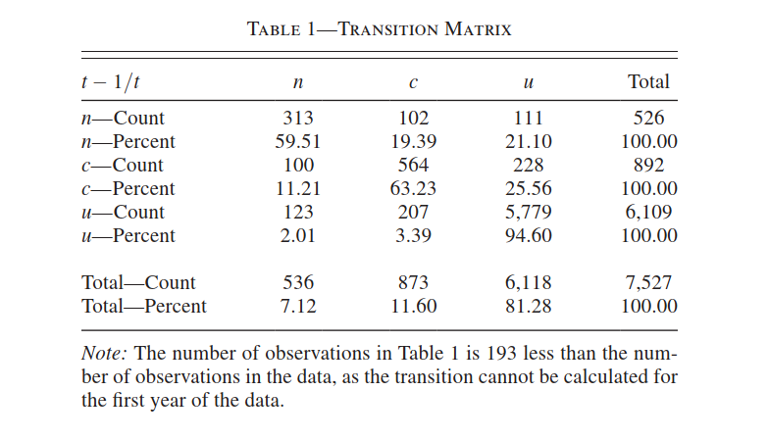



How many cartels are there? (HST AEJMicro 2018)

Slide 12
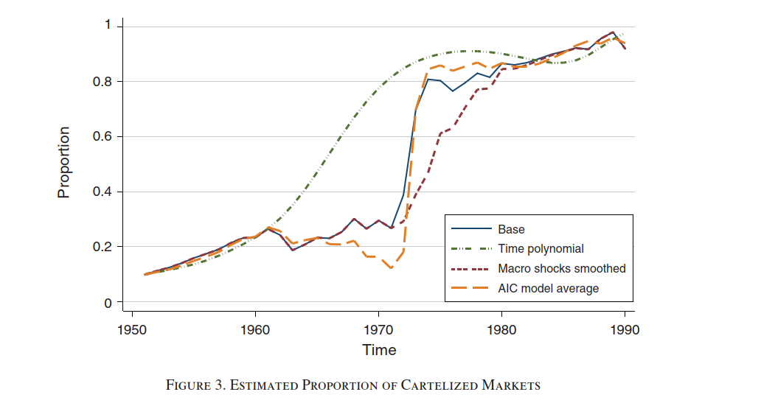
How many cartels are there? (HST AEJMicro 2018)

Slide 13
How many cartels are there? (HST AEJMicro 2018)
The increase in the number of cartels is not due to the demand shock in the early 1970s (oil crises)
Industry price-cost margin positively associated with P(cartel)
➔ legal cartels harmful at least in a static sense
Essentially all Finnish manufacturing cartelized by end of 1980s
Advantage of the methodology: could be applied to data on legal cartels

Slide 14
Natural experiments – potentially very useful for competition policy analysis
Norwegian oil discovery (HST, ongoing work)
Introduction of leniency (Dong, Massa, Zaldokas, 2019. The effects of global leniency programs on margins and mergers, RAND Journal of Economics)
Banning cartels (e.g. Symeonidis, 2008. The effect of competition on wages and productivity: Evidence from the United Kingdom, Review of Economics and Statistics)

