Slide 1
Estimating the costs of non-competition –
Welcome and introduction
Virtual workshop 23/6/2022
Thomas Deisenhofer, Principal Adviser ex post economic evaluation, DG COMP

Slide 2
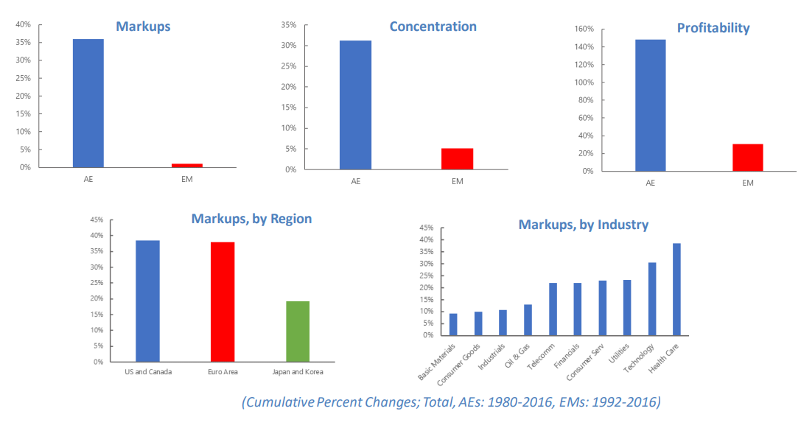
Growing evidence of rising concentration, mark-ups, profitability since 1980
Rise of mean mark ups, concentration and profitability in Advanced Economies - not in EM
Driven by strong rise of mark ups and profits of small group of top firms – no rise for majority of firms
Market position of top firms increasingly entrenched
Akcigit et al. (2021)
?
Lower investments
Lower productivity
Less business dynamism
Declining labour share
Effects on welfare/GDP

Slide 3
Ongoing debates and today’s question
Measurement: (1) estimation of mark ups, (2) reliability of firm level data, (3) trends US vs. EU…
Industry trends vs trends on antitrust markets
Causes of rising market power: (1) causes benign or malign or both? (2) do the causes matter, once we are confronted with more concentrated industries? ..
Effects of rising market power on several macro indicators: (1) link with labour share (2) link with productivity growth (3) link with prices: why did prices until recently not increase? Any connection with recent rapid price increases?
Today’s question:
If it is true that market power has increased, what are the costs for society = the ‘costs of non-competition’?

Slide 4
Past and recent efforts to estimate the ‘costs of non-competition’
Key issues
  How to capture/aggregate effects from various channels?
  Which estimation method: natural experiments vs. macro-modelling?
  Which comparison benchmark(s) for hypothetical less competitive state <=> ‘benefits of competition’?
  Which comparison benchmark(s) for hypothetical more competitive state <=> ‘costs of non-competition’?
Selected estimation efforts
  Harberger (1957)
  Scherer/Ross (1990)
  IMF World Economic Outlook (April 2019)
  Recent attempts: De Loecker/ Eeckhout/ Mongey (2021), Moreau/Panon (2022)
  ….

Slide 5
Agenda for today
13:40 – 14:15 - Estimating the ‘costs of non-competition’ – What is the State of the Art?
  Introductory keynote: Chiara Criscuolo, OECD
  Chair: Pierre Régibeau (CET DG COMP)
14:15 – 15:30 - Insights derived from history, country studies and natural experiments
  Jason E. Taylor (Central Michigan University)
  Otto Toivanen (Aalto University)
  Chair: Vincent Verouden (PA team DG COMP)
  Coffee break
15:45 – 17:00 - The impact of product market competition on labour
  Elena Prager (Northwestern University)
  Jan Eeckhout (Universitat Pompeu Fabra)
  Chair: Guillaume Débarbat (CET DG COMP)
17:00 – 18:15 - Recent Experiences with Modelling the Macro-economic Impact of Competition
  Federico Diez (IMF)
  Jan De Loecker (KU Leuven)
  Chair: Hans Zenger (CET DG COMP)
  18:15 – 18:30 Closing remarks
  Moderators: Guillaume Débarbat, Moritz Suppliet

Slide 6

Thank you
© European Union 2020
Unless otherwise noted the reuse of this presentation is authorised under the CC BY 4.0 license. For any use or reproduction of elements that are not owned by the EU, permission may need to be sought directly from the respective right holders.
Slide xx: element concerned, source: e.g. Fotolia.com; Slide xx: element concerned, source: e.g. iStock.com
Notes:
Update/add/delete parts of the copy right notice where appropriate.
More information: https://myintracomm.ec.europa.eu/corp/intellectual-property/Documents/2019_Reuse-guidelines%28CC-BY%29.pdf

