Slide 1
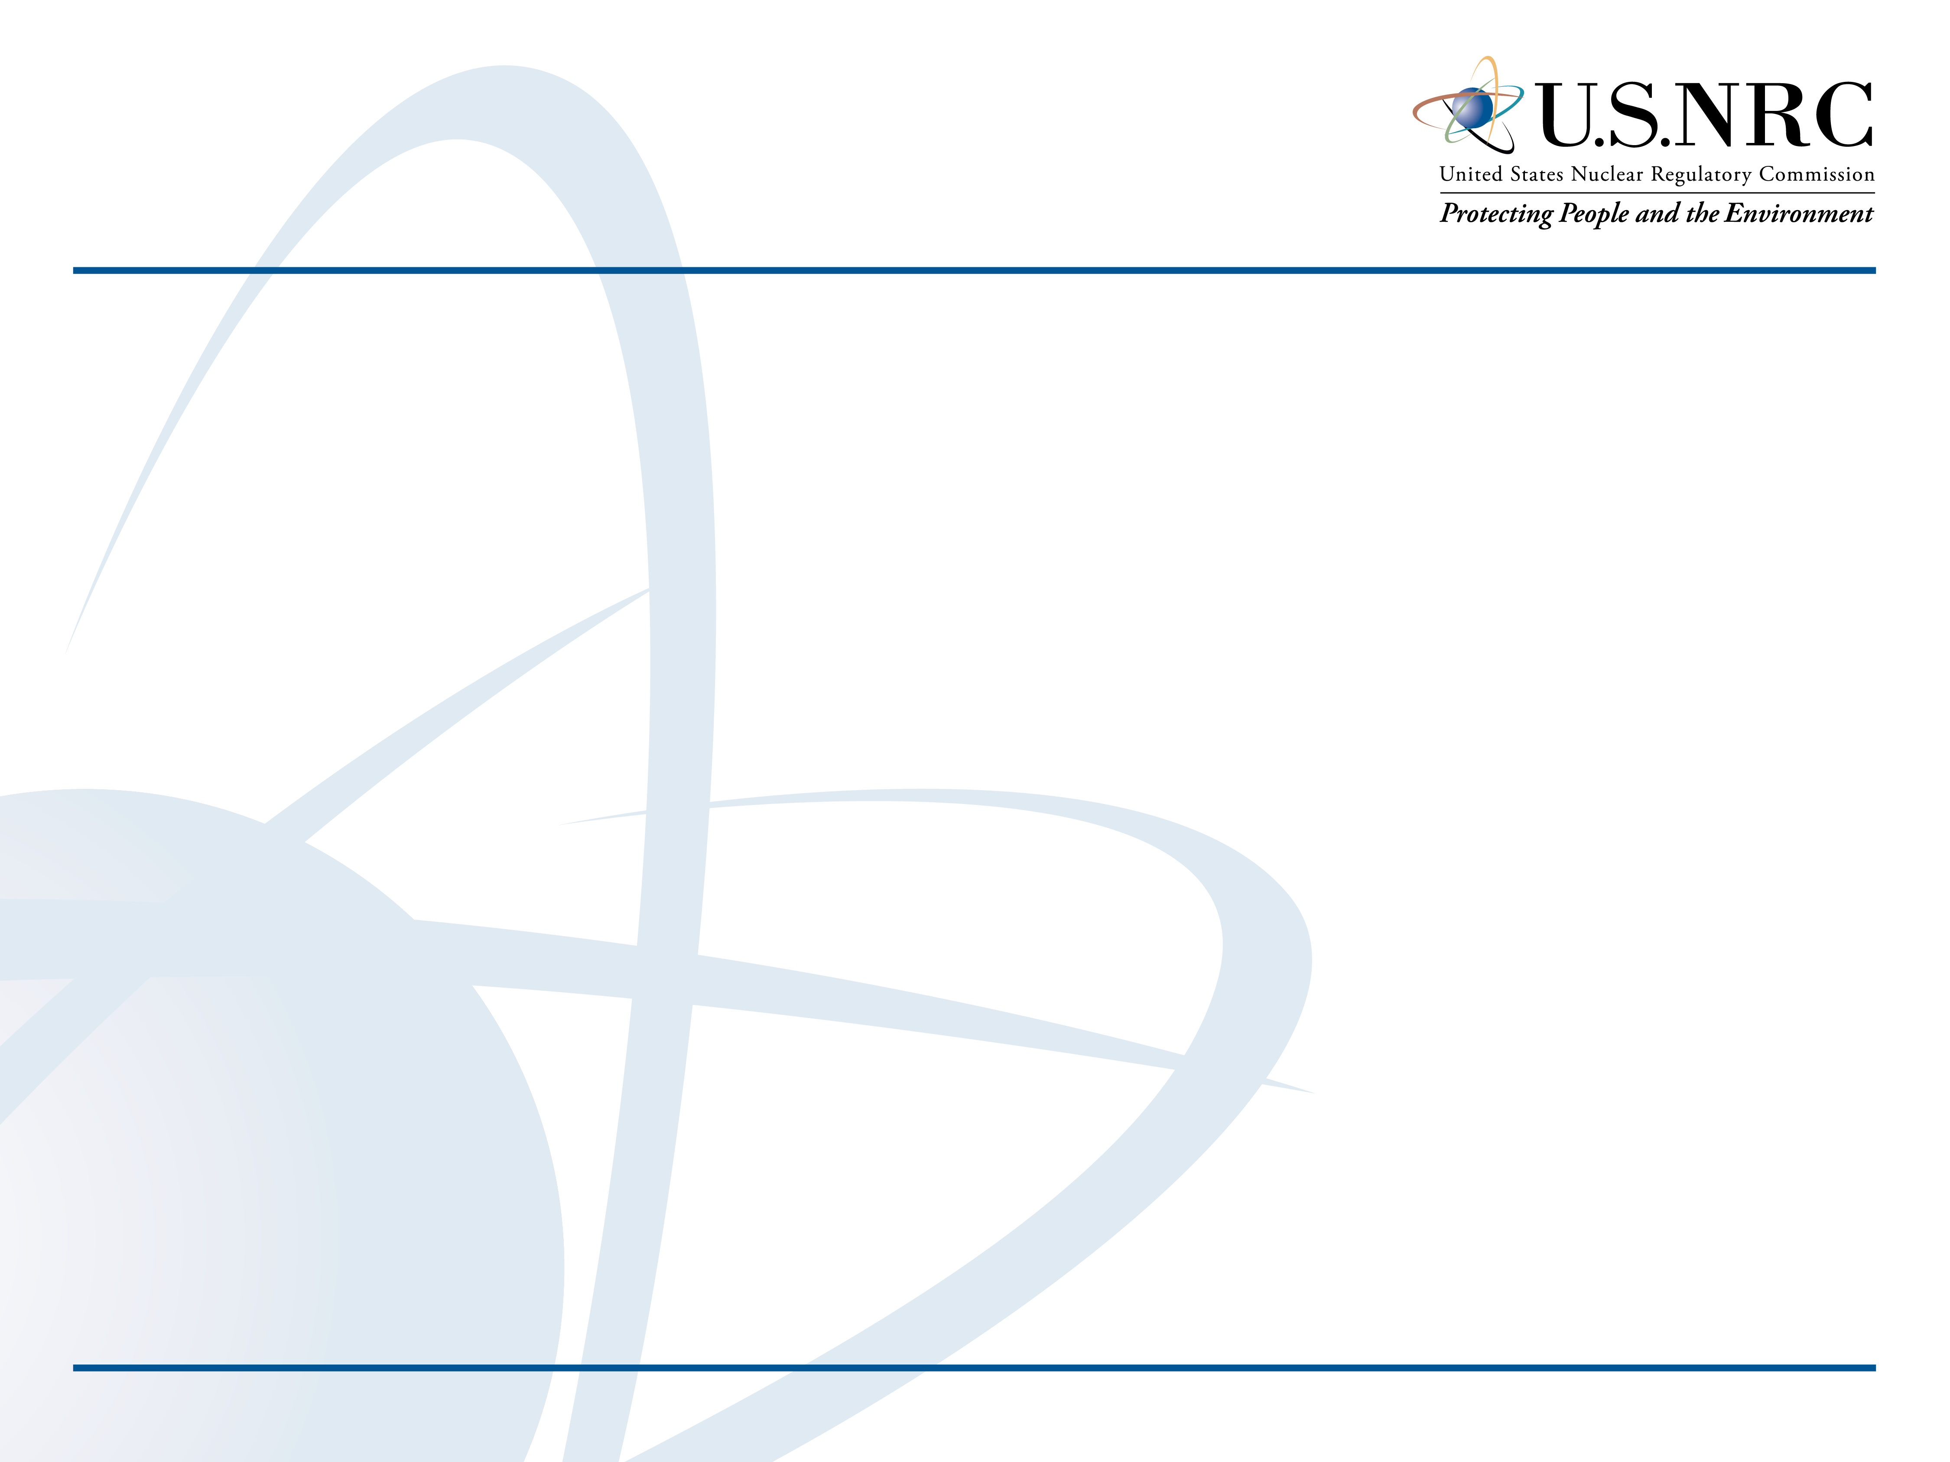
NRC Update on Regulatory Activities Affecting
Industrial Radiography
Monica Ford
Regional State Agreements Officer
US NRC Region I
Monica.Ford@nrc.gov

Slide 2
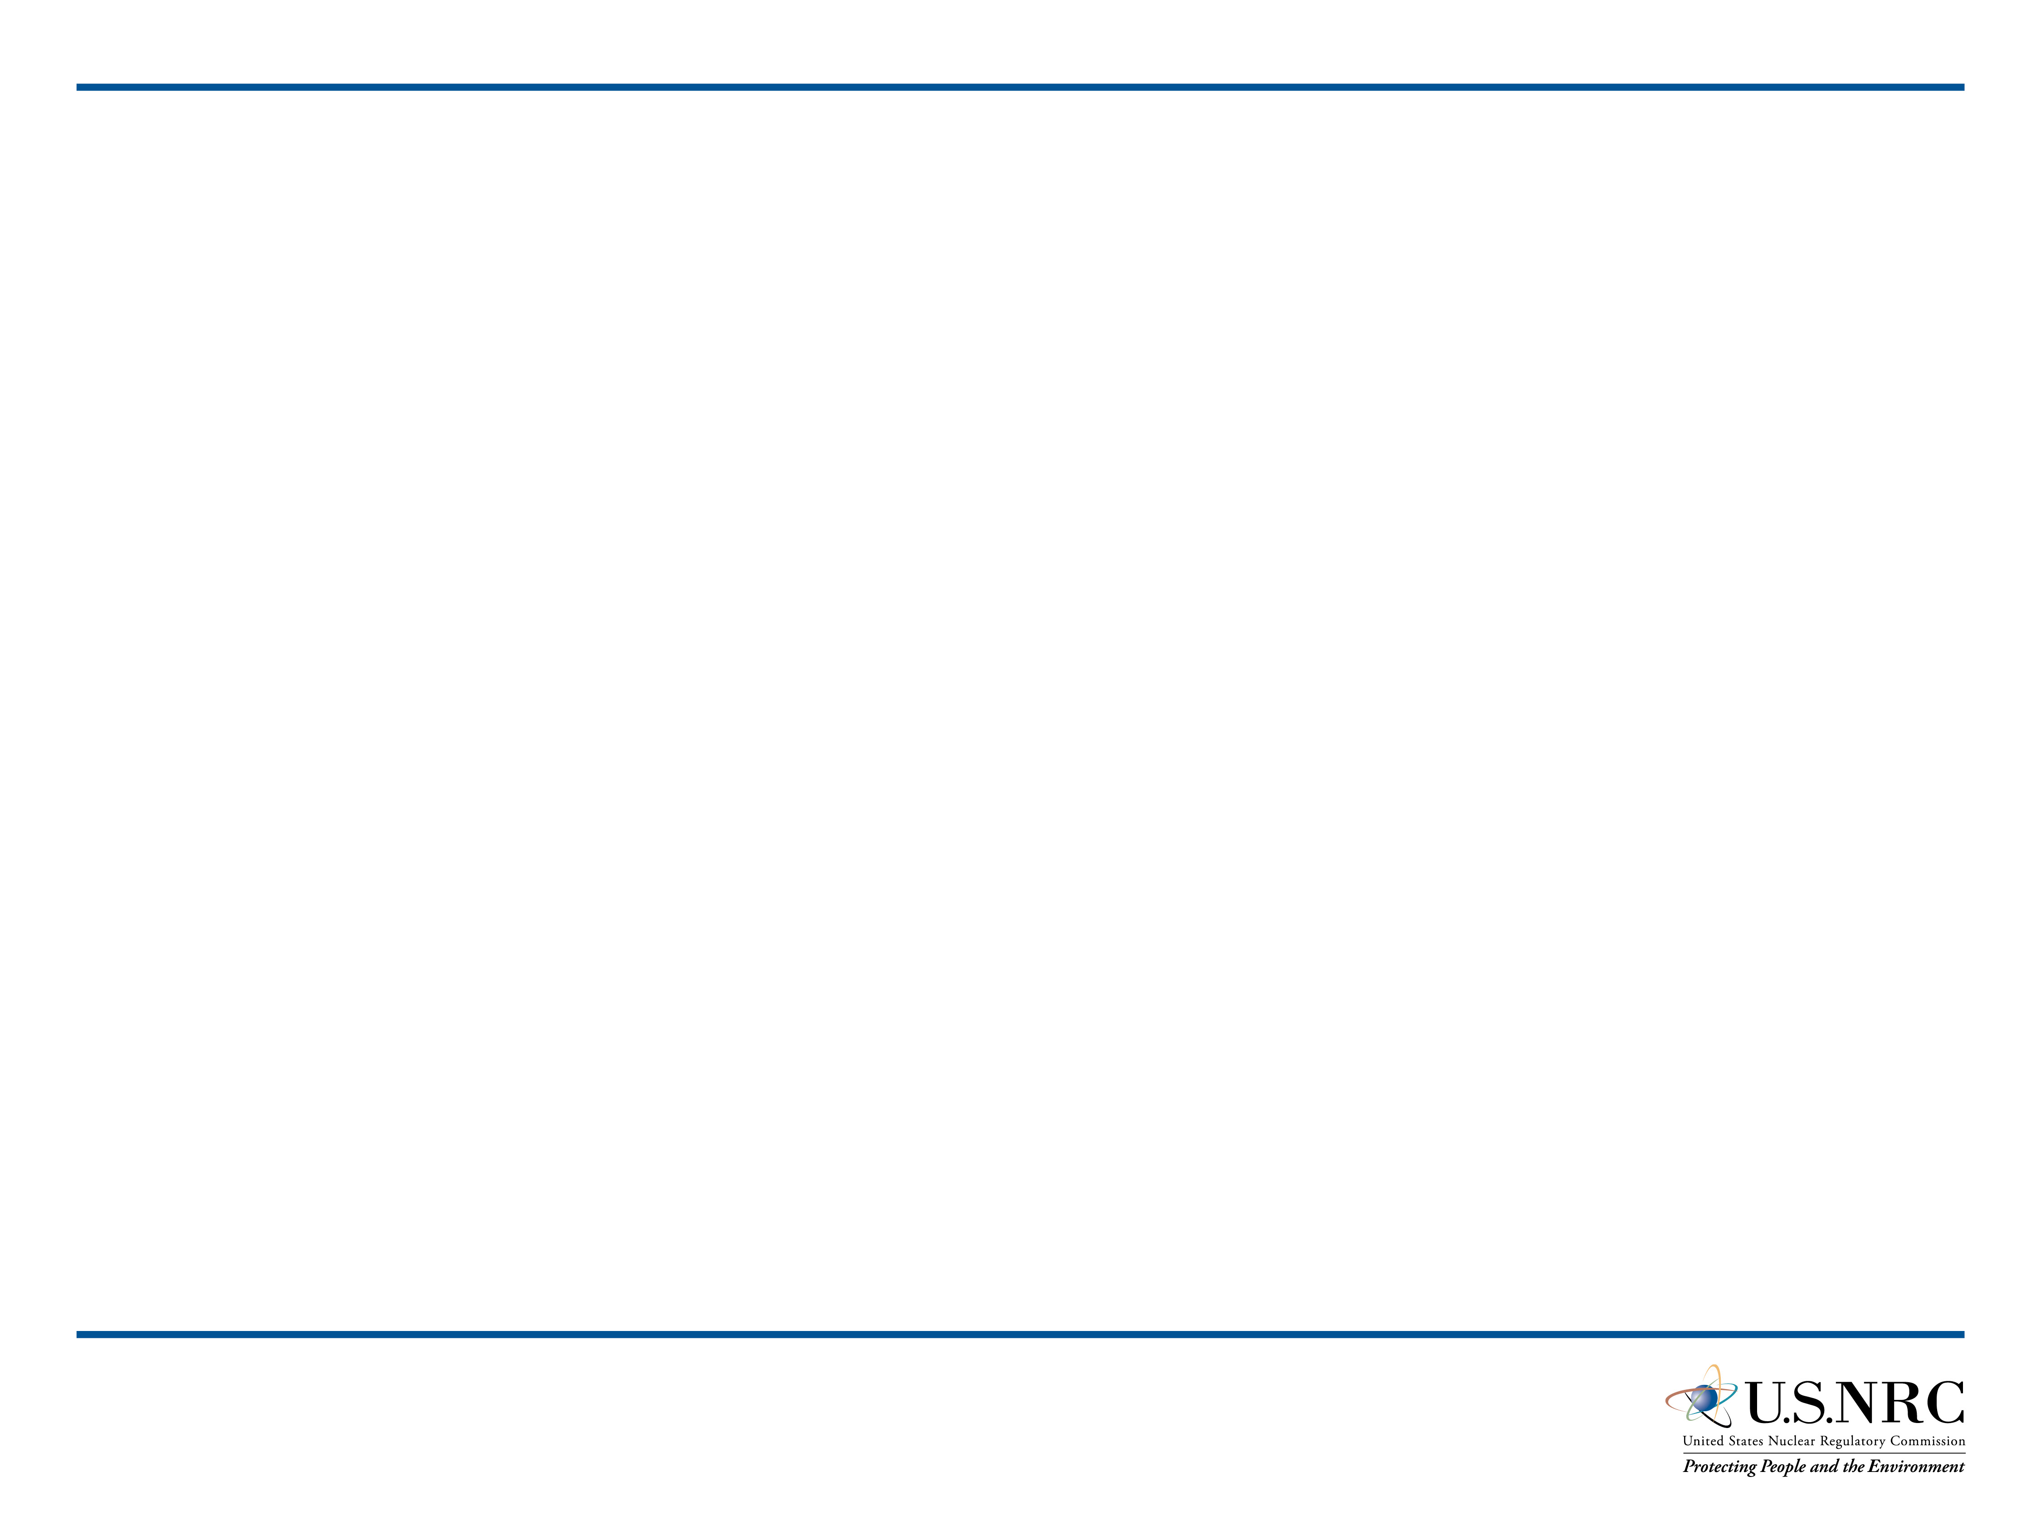
Topics
PRM-34-6: Two Man Rule
PRM-34-7: Electronic Dosimetry
EGM 18-001: Dispositioning violations involving direct ion storage dosimetry

Slide 3
Petition to Clarify Training, Surveillance and Two-Man Rule Requirements
PRM-34-6

Slide 4
PRM-34-6 Request
Requested based on difference between NRC and State of Texas on implementation of two-man rule
Submitted by Organization of Agreement States in November 2005
Proposed Amendments to Part 34
  34.41(a): two qualified individuals present, but second person no longer required to observe the operations
  34.43(c): additional requirement for radiographer assistant complete 40 hours training course
  34.51: change to require radiographer provide direct visual surveillance of high radiation area

Slide 5
PRM-34-6 Chronology
OAS Letter dated November 3, 2005
Federal Register Notice published
  December 28, 2005
  Two comments received
PRB held public meeting held to discuss issues raised in petition
  August 15, 2007

Slide 6
PRM-34-6 Current Status
PRB Decision
  Issues and concerns raised in petition merit further consideration and inclusion in rulemaking
  Published in Federal Register on May 14, 2008 (73 FR 27771)
Working Group formed in 2018
  Review 2005 – 2007 information
  Prepare rulemaking plan

Slide 7
Electronic Dosimeters
PRM-34-7

Slide 8
PRM-34-7 Chronology
NDTMA/ASNT Letter dated July 14, 2016
  Docketed as PRM-34-7
Federal Register Notice
  Published November 9, 2016
  13 comments received
Working Group formed
  Prepared cost-benefit analysis
Petition Review Board (PRB) meetings
  May 2017
  October 2017

Slide 9
PRM-34-7 Current Status
Petition Review Board Decision
  Amend Parts 20, 34, 36 and 39 to allow use of digitally read personnel dosimeters
  Amend Part 34 to allow dual-function devices
  Prohibit triple-function devices
  Pursue as direct final rule
Commission Paper in concurrence to approve rulemaking plan
17

Slide 10
Revised Policy on Combination Dosimetry Devices
RIS 2017-06 issued September 19, 2017
  NRC Policy on Use of Combination Dosimetry Devices During Industrial Radiography Operations
Licensees may use combined dosimetry devices, also known as electronic alarming dosimeters, as a dual-function device for meeting the direct reading dosimeter and the alarm ratemeter device requirements specified in 10 CFR 34.47(a).
17

Slide 11
Instadose
(An NRC perspective)

Slide 12
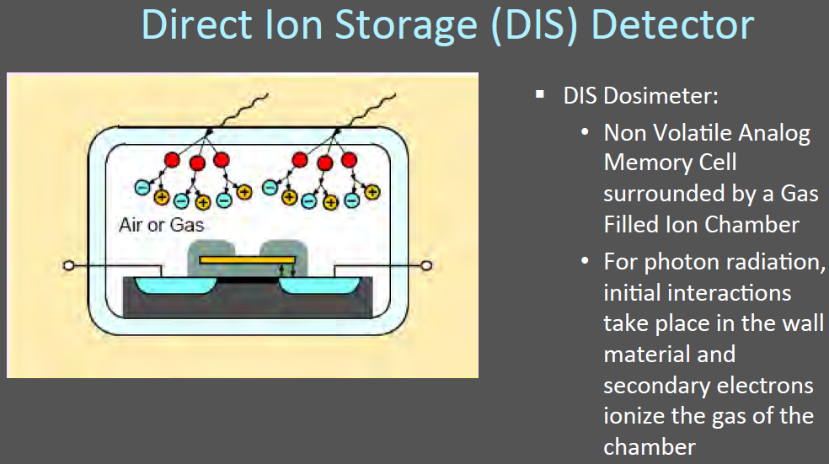
How Direct Ion Storage Device Works in Practice
(Only one known commercial version - Instadose)
Doses are read instantly and locally.
– No sending, No waiting, No transit controls.
– Dosimeters are immediately reused.
– Automated tracking and reporting.

Slide 13


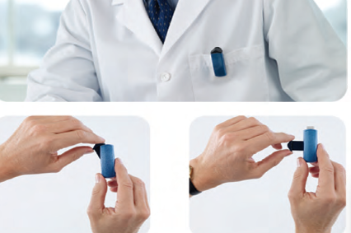
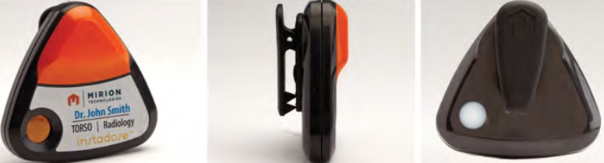
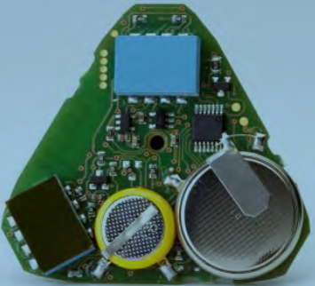
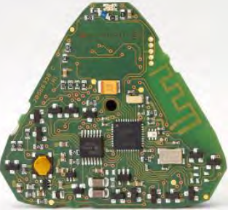
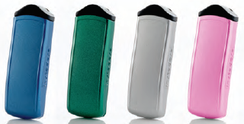
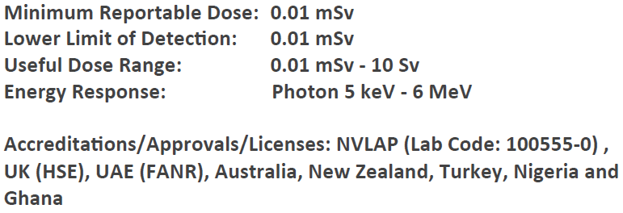
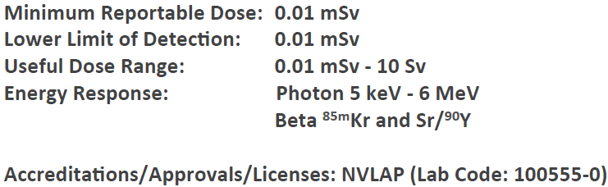
Two versions – Instadose 1 and 2

Slide 14
Key Components
One of more transistors on the device are initially charged by the NVLAP accredited vendor and the device is sent to the licensee for use.
The charge on the transistor is depleted as radiation interacts with the sensitive volume.
The change in voltage or capacitance across the transistor gate over the issue (wear) period is proportional to dose.
The DIS dosimeter outputs through USB port or Blue Tooth a voltage/ capacitance reading to a local computer/ device (paradigm shift).
The reading is non-destructive and the change in voltage is tracked throughout the operational life of the dosimeter.
A proprietary mathematical algorithm calculates a dose from the change in readings over the issue period and performs self-diagnostics of the dosimeter’s health.
The dosimeter is not sent back to the NVLAP accredited processor.

Slide 15
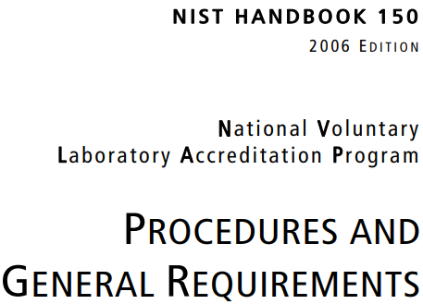
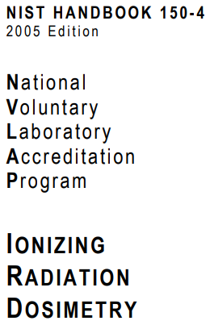
NVLAP Accreditation – What it Is and What it is Not
NVLAP provides accreditation to an entity to process and evaluate using a specific dosimetry system for specifically defined radiation fields. This is referred to as the “scope” of accreditation.
NVLAP accreditation includes site visits every 2 years, blind proficiency testing every 2 years, and detailed technical and quality reviews IAW NIST HB-150 (ISO 17025) and NIST HB-150-4.
NVLAP DOES NOT accredit a dosimetry system
NVLAP DOES NOT provide for an equipment accreditation
NVLAP Proficiency Testing is NOT Type Testing
(Identical to ISO 17025)

Slide 16
Enforcement Guidance Memorandum
18-001

Slide 17
10 CFR 34.47(a)
(a) The licensee may not permit any individual to act as a radiographer or a radiographer's assistant unless, at all times during radiographic operations, each individual wears, on the trunk of the body, a direct reading dosimeter, an operating alarm ratemeter, and a personnel dosimeter that is processed and evaluated by an accredited National Voluntary Laboratory Accreditation Program (NVLAP) processor. At permanent radiography installations where other appropriate alarming or warning devices are in routine use, the wearing of an alarming ratemeter is not required.
(1) Pocket dosimeters must have a range from zero to 2 millisieverts (200 millirems) and must be recharged at the start of each shift. Electronic personal dosimeters may only be used in place of ion-chamber pocket dosimeters.
(2) Each personnel dosimeter must be assigned to and worn only by one individual.
(3) Film badges must be replaced at periods not to exceed one month and other personnel dosimeters processed and evaluated by an accredited NVLAP processor must be replaced at periods not to exceed three months.
(4) After replacement, each personnel dosimeter must be processed as soon as possible.

Slide 18

What should inspectors do?

Slide 19
Questions?

