Slide 1
DIRECTORATE GENERAL FOR INTERNAL POLICIES
PETITIONS
The role of ombudsmen and petitions committees in detecting breaches of EU law

Slide 2
Structure
Differences in the roles of ombudsmen and petitions
Differences between complaints and petitions
Best practices

Slide 3
Differences in the roles of ombudsmen and petitions committees in the Member States
Scope of the twin rights
The right to petition
Complaints to ombudsman
Focus on procedure; focus on decision
Difference reflected in the importance given to the procedure
Res privata and res publica

Slide 4
Differences between complaints and petitions
As a form of political participation | RIGH TO PETITION | OMBUDSMAN | As a form of democracy (Representative / Advocacy / Direct)
Conventional / non-conventional | Conventional | Conventional | Advocacy democracy
Direct / indirect | Direct | Indirect
Legal / illegal | Legal | Legal
Mode of action | Individual or collective | Individual or collective
Scope of results | General and (in some cases) Particular | Particular and (in some cases) General
Scope of action | Diversified | Diversified
Degree of effort | reduced | reduced
Initiative | Impulse, timing and object depends on the petitioner | Impulse, timing and object depends on the petitioner
Frequency of use | Without limitations | Without limitations

Slide 5
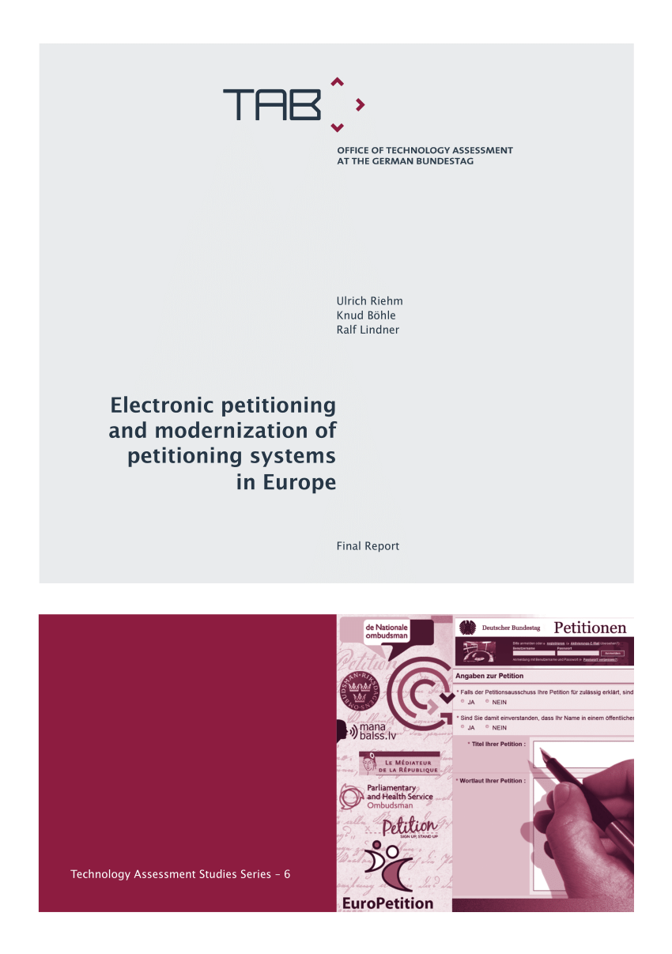
Best practices in the work of national ombudsmen and petitions committees
Reaching the underrepresented
Who can and who does participate
The weakness of ‘advocacy democracy’
Important to learn about who is engaging
Monitoring
The Ombudsman of Lithuania conducts public perception surveys on a yearly basis.
This allowed the Ombudsman’s Office to learn which group of citizens were less aware of the institution’s role and it directed its awareness campaigns towards those particular groups.
Source: OECD (2018)

Slide 6
Best practices in the work of national ombudsmen and petitions committees
Hearings and debates
EP | Scotland | UK | Portugal | Luxembourg
The EP petition system promotes petitioners’ participation in committee meetings where they can be heard if their petition is placed on the agenda, and matters raised by the petitions can be debated in committee and eventually in plenary. The Petitions Committee however does in practice restrict its use of the latter possibility to a few selected cases considered of broader political importance. | Hearings and debates in committee are common practice and there is no threshold. Government members or executive representatives often participate in the committee meetings and petitioners are invited to attend and can also ask questions directly, which happens frequently. | In the new e-petition system (since 2015), there is a threshold of 100,000 signatures for a petition to be considered for debate. With 10,000 signatures, the petition is entitled to receive a response from the Government. | Hearings are mandatory for petitions with more than 1,000 signatures (in these cases petitioners have the right to be heard). Petitions with more than 4,000 signatures are debated in plenary. Hearing and debates are broadcasted on the Parliament TV. | Petitions that collect within 42 days more than 4,500 signatures are debated in a joint meeting between the Petitions Committee and the competent standing committee for the matter. The minister concerned shall also be present, as well as the petitioner(s). The debate is broadcast on the Parliament TV.

Slide 7
Best practices in the work of national ombudsmen and petitions committees
Interaction with the supporters of petitions/complaints
Notification by e-mail of the main steps and stages taken.
Guarantee that all those who support these initiatives receive feedback.
The Portuguese Parliament introduced in 2017a petitions platform that allows communication with all the petition’s signatories.
The UK petition system provides to signatories emails with updates about what happens in Parliament with petitions supported by them.

Slide 8
Best practices in the work of national ombudsmen and petitions committees
The importance of electronic tools
Reaching out to citizens who may otherwise be less inclined to institutional political participation.
Promote citizens’ engagement in the
political process.
Open process
Major contribution
Transformation of the process to become
more public
Engagement of the community that otherwise would not be possible
The intermediary nature of the ombudsman
Full examples of e-petitions: Scotland, Portugal or Luxembourg
Publish the petition texts and the main documents, as well as information on the petition stage and corresponding dates.
The Ombudsman of the Czech Republic has a comprehensive and easy to use search engine to find individual cases.

Slide 9
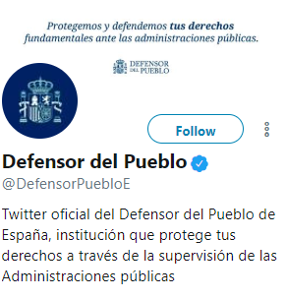
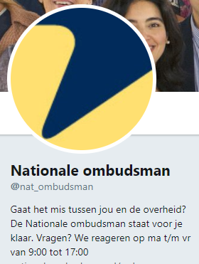
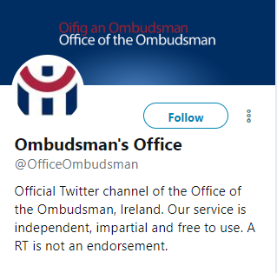
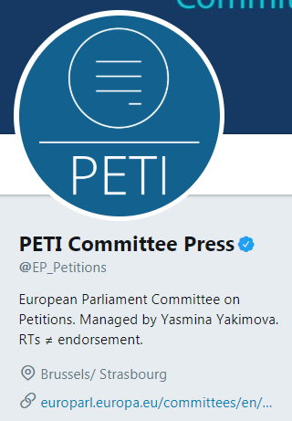
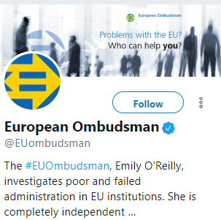
Best practices in the work of national ombudsmen and petitions committees
Social Media
Enhance visibility
Improved provision of information to the public on what is done.
Reaching hitherto ignored audiences.
Discussions that enables to tap into real-time reactions from the public.

Slide 10
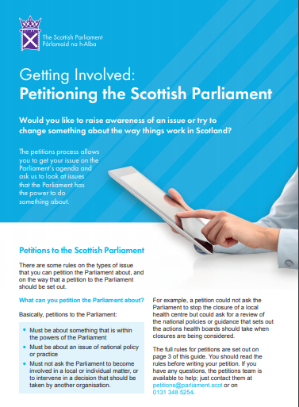
Best practices in the work of national ombudsmen and petitions committees
Communication
Raising awareness among citizens about their existence and roles,
Creating a link between citizens and public institutions and seeking input from relevant players.

Slide 11
Best practices in the work of national ombudsmen and petitions committees
Cooperation and information sharing
The European Network of Ombudsmen (ENO) helps
to share information about EU law and its impact in EU Member States.
facilitates cooperation between ombudsmen
As for the petition committees, instruments like the Representatives of National Parliaments to the EU can be useful.
But none of the existing cooperation instruments (between the European Parliament and the national parliaments) seem particularly well suited to support the examination of petitions.

Slide 12
Recommendations for ombudsmen and petitions committees
Ensure that breaches of EU law and citizens’ rights are detected and corrected
Social media
Networking
Collecting data
Chapter in annual report

Slide 13
Recommendations for ombudsmen and petitions committees
Ensure greater visibility and closer contact with the citizen
Easier participation
Communication with all participants
Social media
Monitoring and evaluation
Targeted campaigns

Slide 14
Presentation by
Tiago Tibúrcio
CIES- Lisbon University Institute
Policy Department Citizens’ Rights and Constitutional Affairs
Responsible Administrator: Jos HEEZEN
poldep-citizens@europarl.europa.eu

